Slide 1
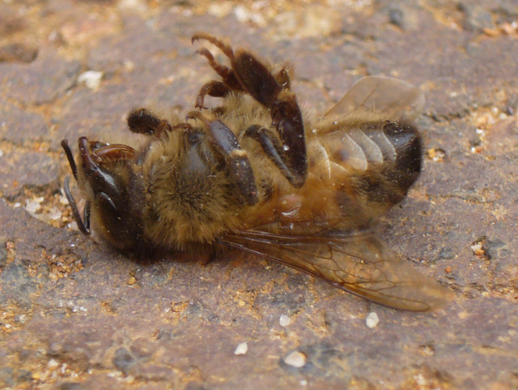
What’s up with all the talk about bees going extinct?

Slide 2
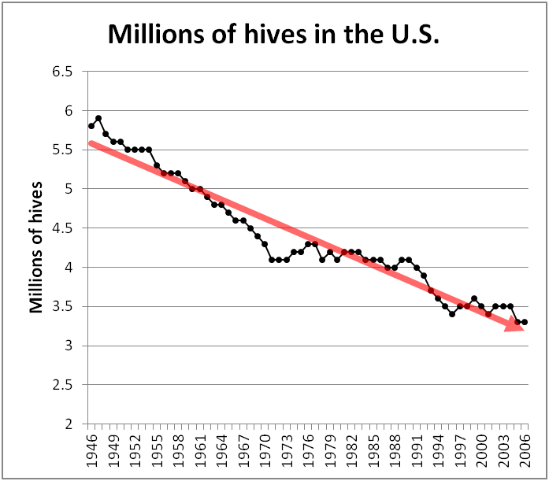
The Slow Extinction of the Honey Bee

Slide 3
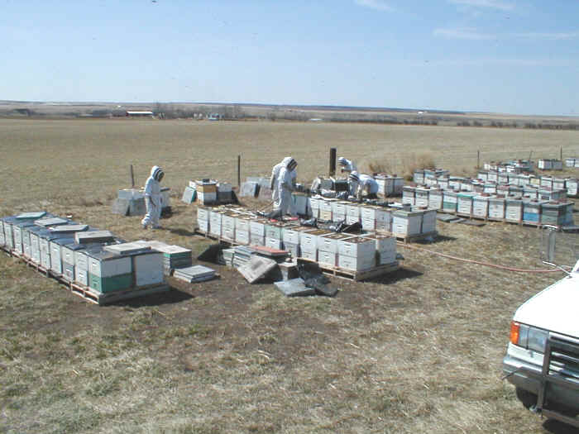
The number of hives is all about profitability.

Slide 4
Beekeepers respond to market opportunity

Slide 5
changes in the niches of the honey bee and
The beekeeper

Slide 6
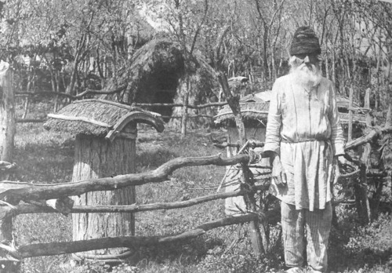
Russia 1908
Provide a nest box for a wild animal.

Slide 7
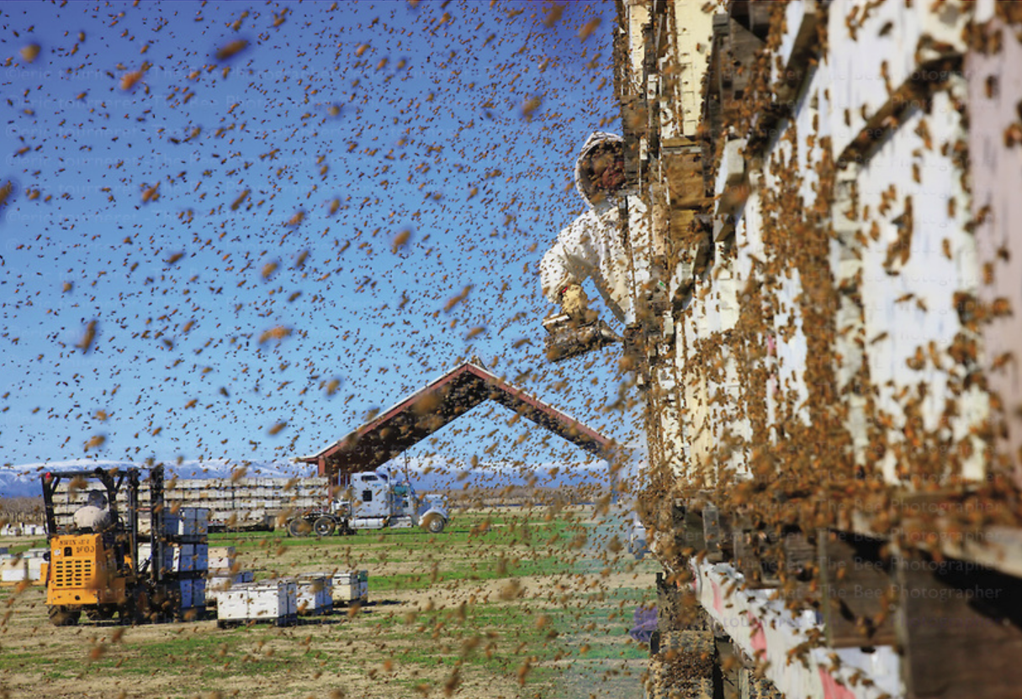
Eric Tourneret
Bees now managed as industrial livestock.

Slide 8
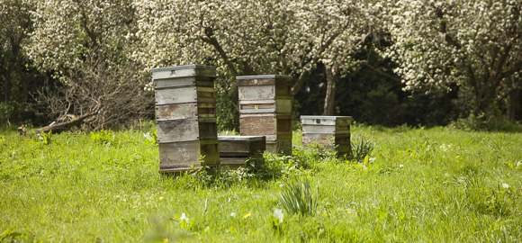
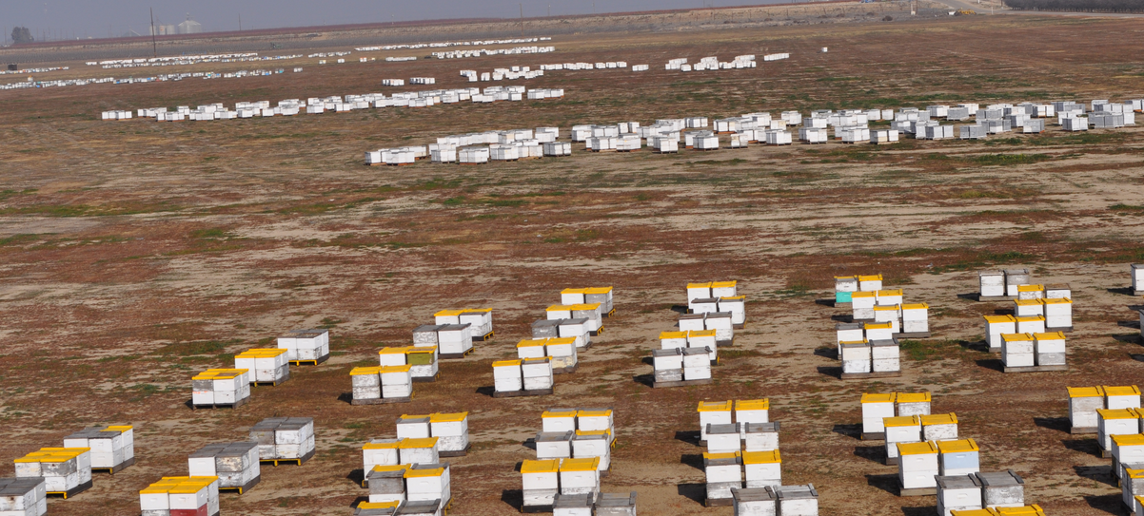
Poor fit.
Good fit to natural niche.

Slide 9
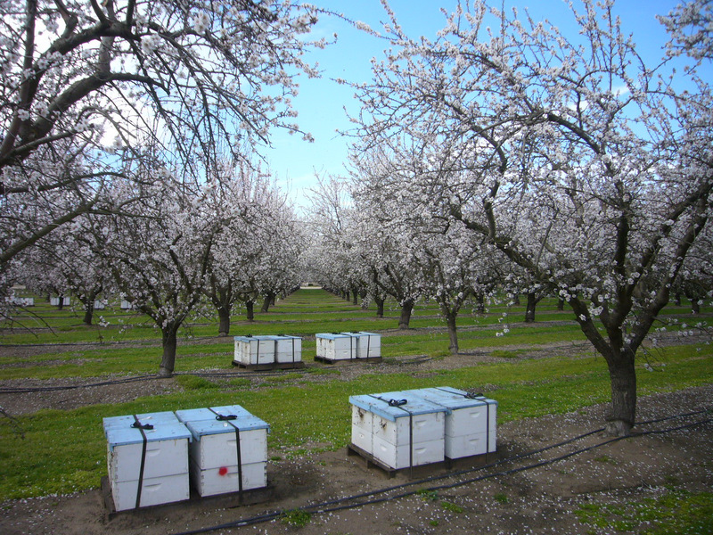
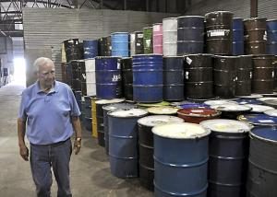
$180 pollination equivalent to
90-lb honey crop
Beekeeper niche shift:
necessity of almond pollination income
2012 est. pollination fees $230M
2012 bulk honey sales $286M

Slide 10
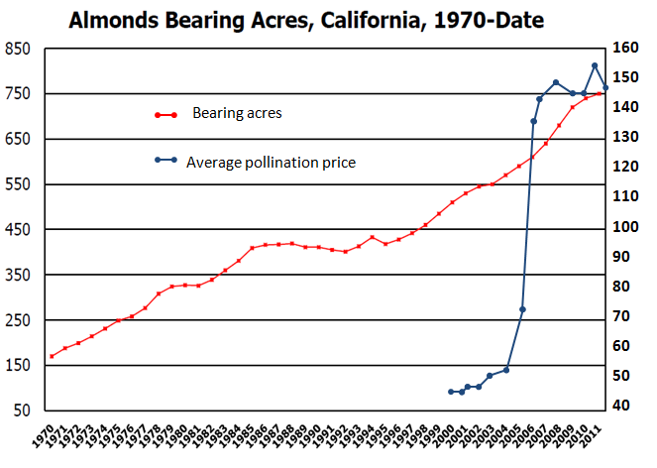

Slide 11
Economics, sex, bees, and environmental competition

Slide 12
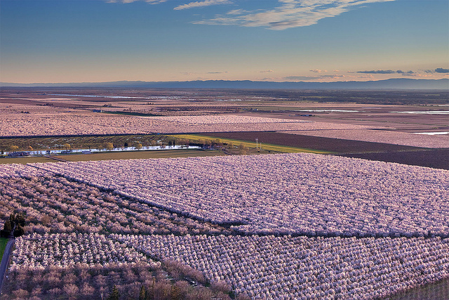
ECONOMICS
California grows >80% of the worlds’ almonds
Farmgate value: $4 billion
100% dependent upon bee pollination
Anthony Dunn

Slide 13


Sex
Gametes
Allows evolutionary adaptation

Slide 14
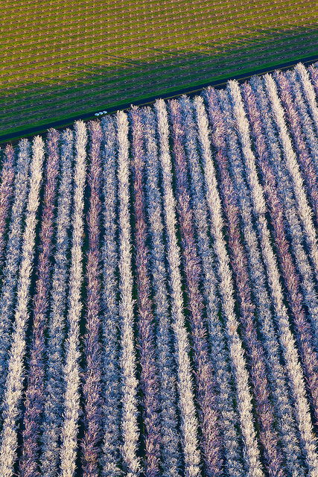
Almond Sexual
Requirements
Anthony Dunn

Slide 15
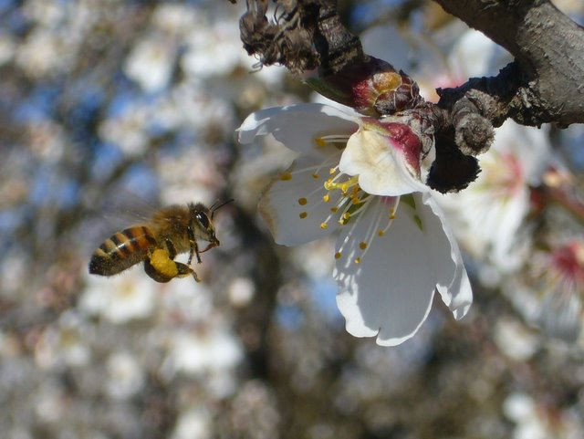

Slide 16
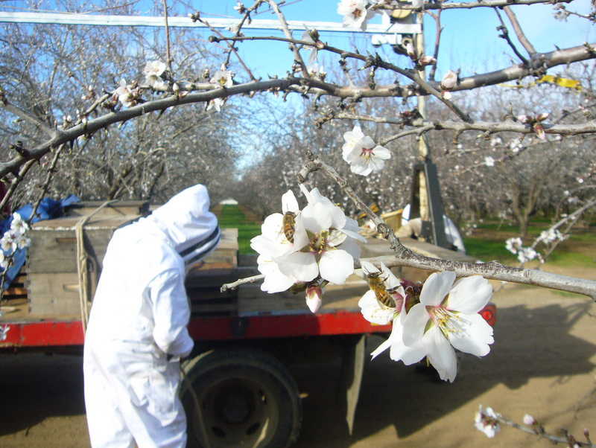

Slide 17
Late February

Slide 18
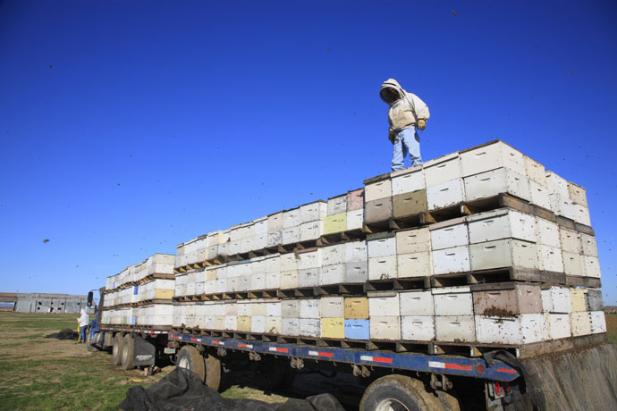
Almonds require 1.6 million hives every February
>70% of U.S. colonies are managed by fewer than 2000 commercial beekeepers
Photo: The Honey Gatherers

Slide 19
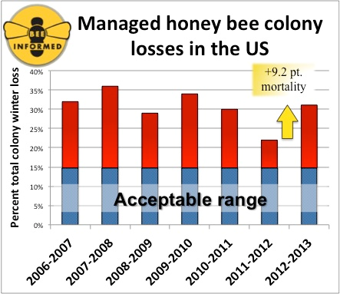
Why today’s high colony mortality rate?

Slide 20
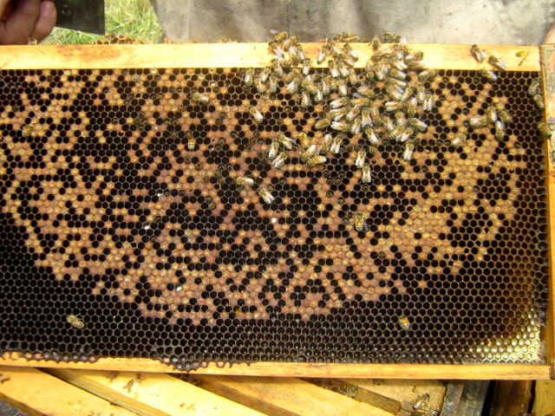
Only a small proportion reported as CCD symptoms

Slide 21
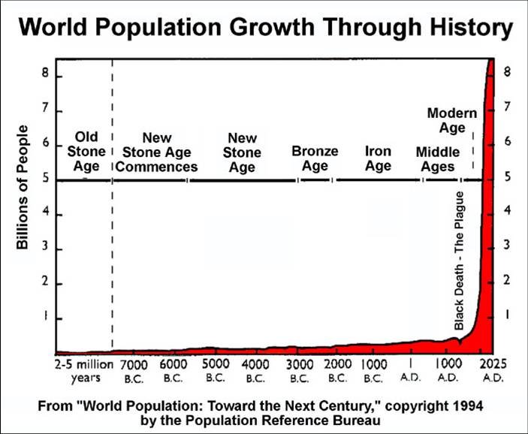
Honey bees are suffering from human-caused problems.

Slide 22
the three MAJOR problems: parasites lack of forage
Pesticides

Slide 23
Parasites

Slide 24
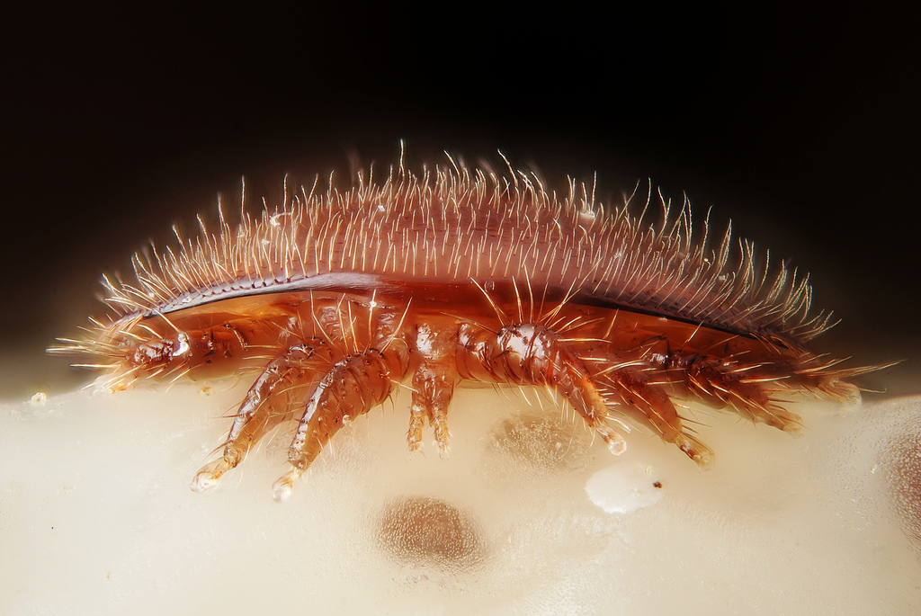
The catastrophe of varroa
Gilles San Martin
Notes:
Back to managing varroa.

Slide 25
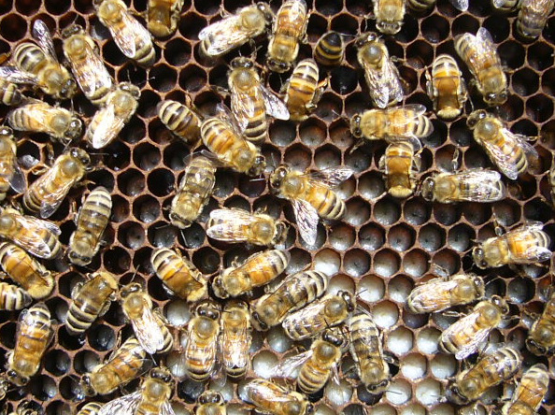
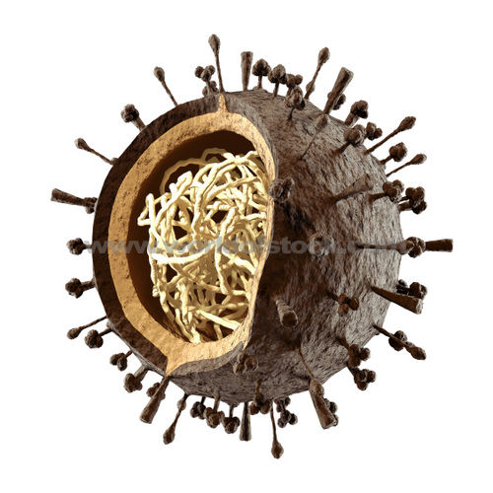
Horizontal virus
transmission
without
varroa
Through the gut wall

Slide 26
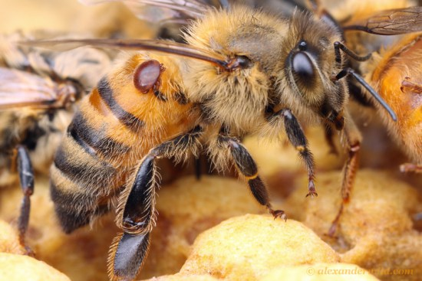

Virus
transmission
by
varroa
Mainline via the mite

Slide 27
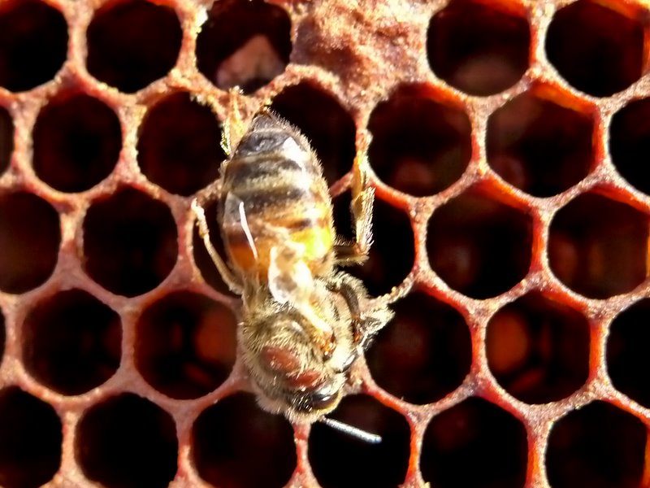
Deformed wing virus
Notes:
Remember, attrition is generally invisible—the sick bees simply fly away!

Slide 28

0 yrs
>3 yrs
0 yrs
2009 0 yrs
2010 >2 yrs
2009 <1 yr

Slide 29
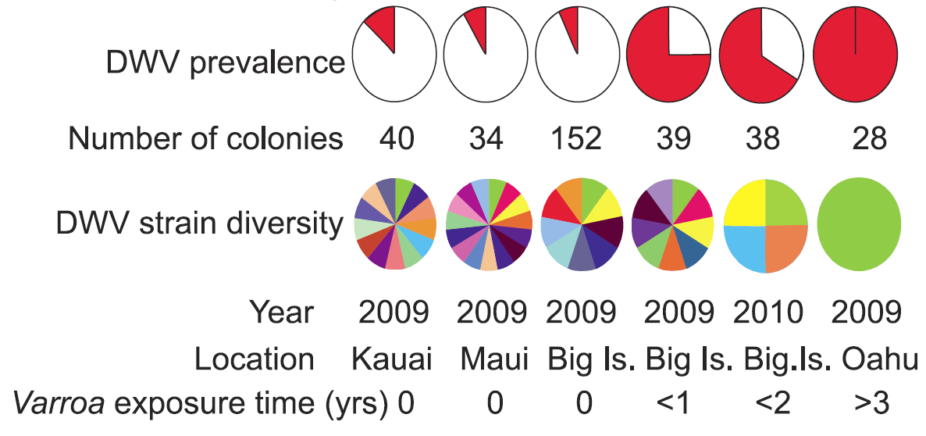
Stephen Martin
Viruses quickly evolved to take advantage of the new vector

Slide 30
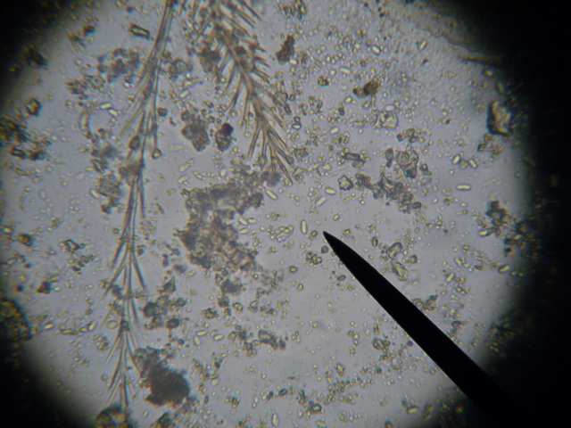
Plus:
A new intestinal parasite:
Nosema ceranae
Notes:
Remember, attrition is generally invisible—the sick bees simply fly away!

Slide 31
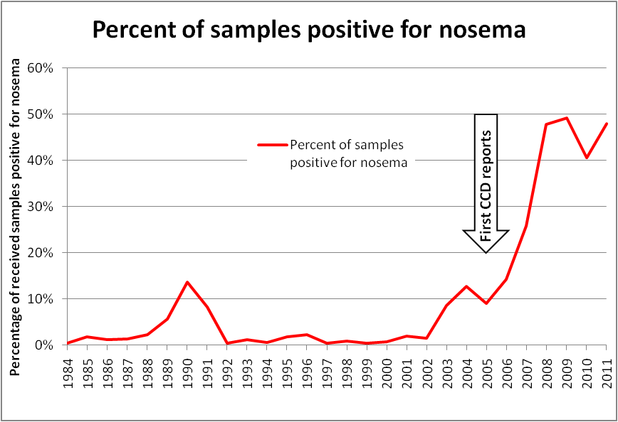
Data from Bart Smith USDA Bee Disease Diagnostic Lab

Slide 32
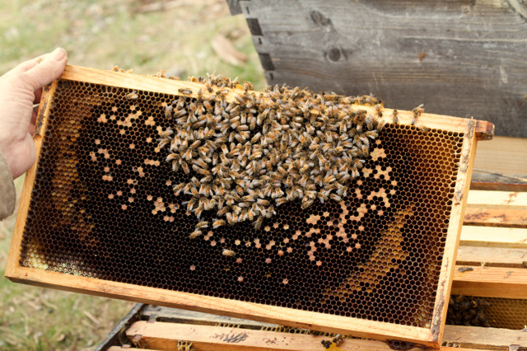
Colony mid collapse Feb 2012—8/10 bees infected!
Nosema-induced colony collapse

Slide 33
MAJOR CHANGE:
Forage

Slide 34
The honey bees’ main environmental competitor

Slide 35

The honey bees’ main environmental competitor

Slide 36
The honey bees’ main environmental competitor
7 billion humans to feed.
200,000 new mouths a day.
Americans expect cheap, cosmetically perfect food.
There are environmental costs.

Slide 37
the #1 environmental cost: destruction of habitat

Slide 38
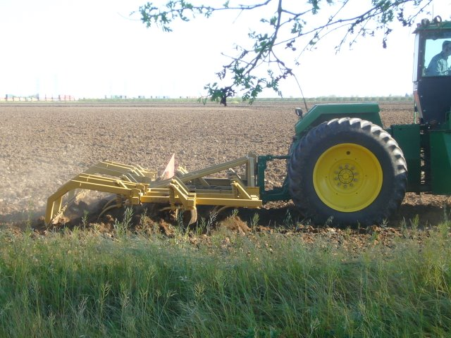

Slide 39
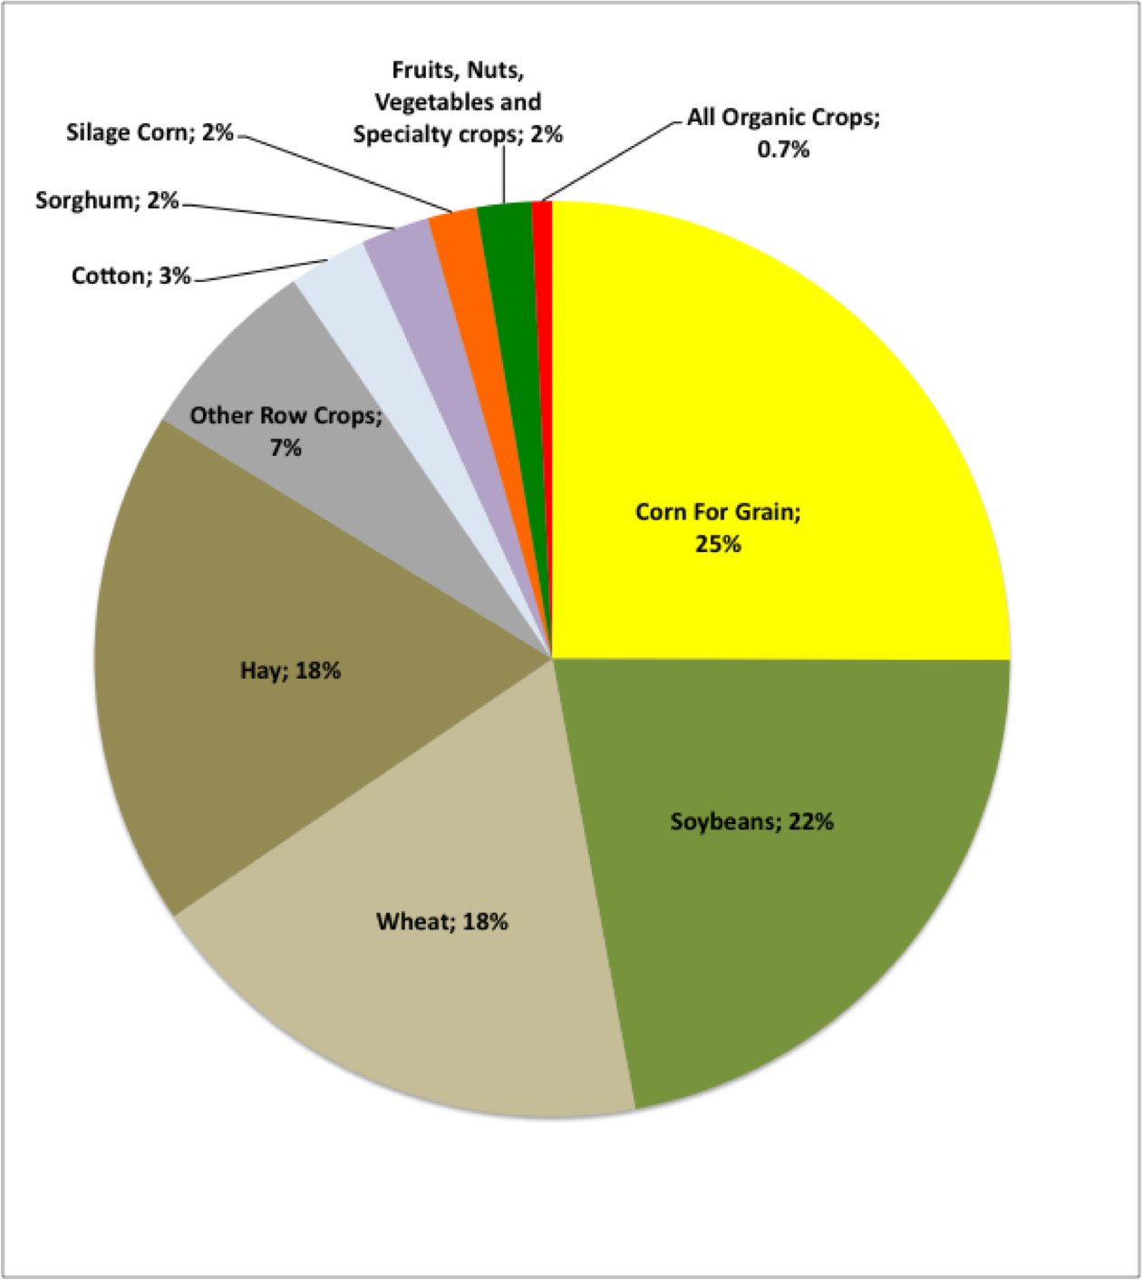
Steve Savage
Only a small fraction of cultivated land is bee friendly.

Slide 40
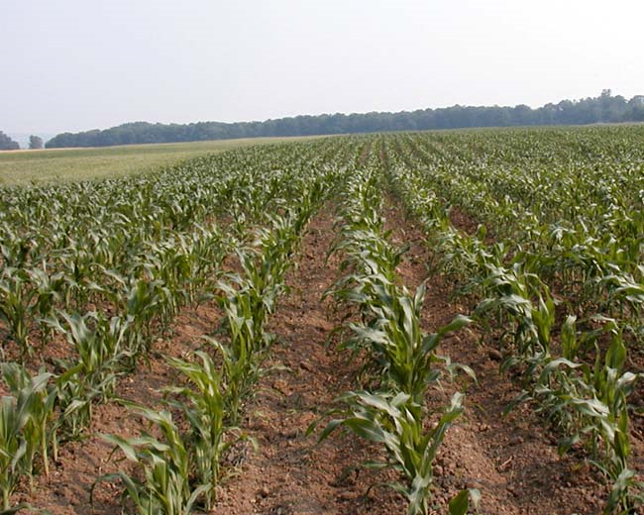
  Loss of good bee and wildlife pasture
    Massive fencepost-to-fencepost monoculture
    “Clean farming”
    Heavy use of herbicides
    and other pesticides

Slide 41
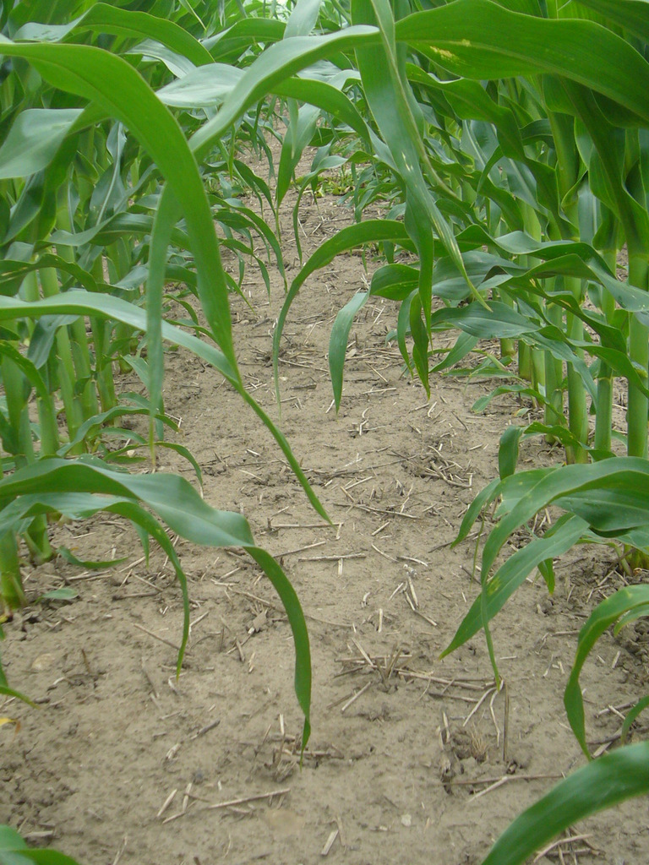
EFFICIENCY IN FARMING
IS AT ODDS WITH WILDLIFE HABITAT

Slide 42
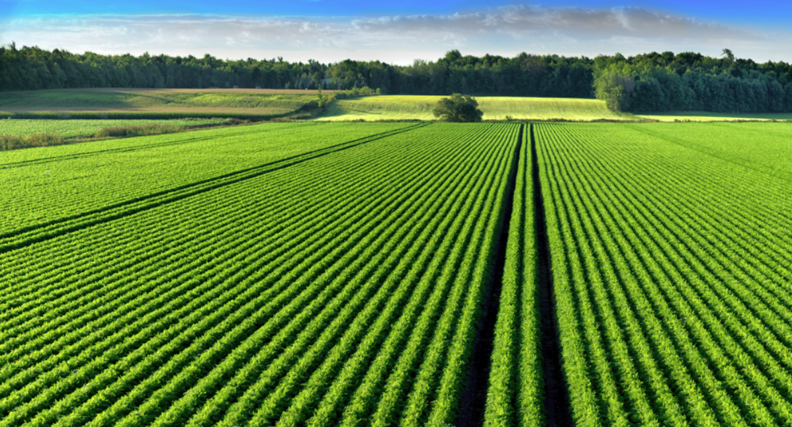
Laurent Lucuix
Green agro-deserts

Slide 43
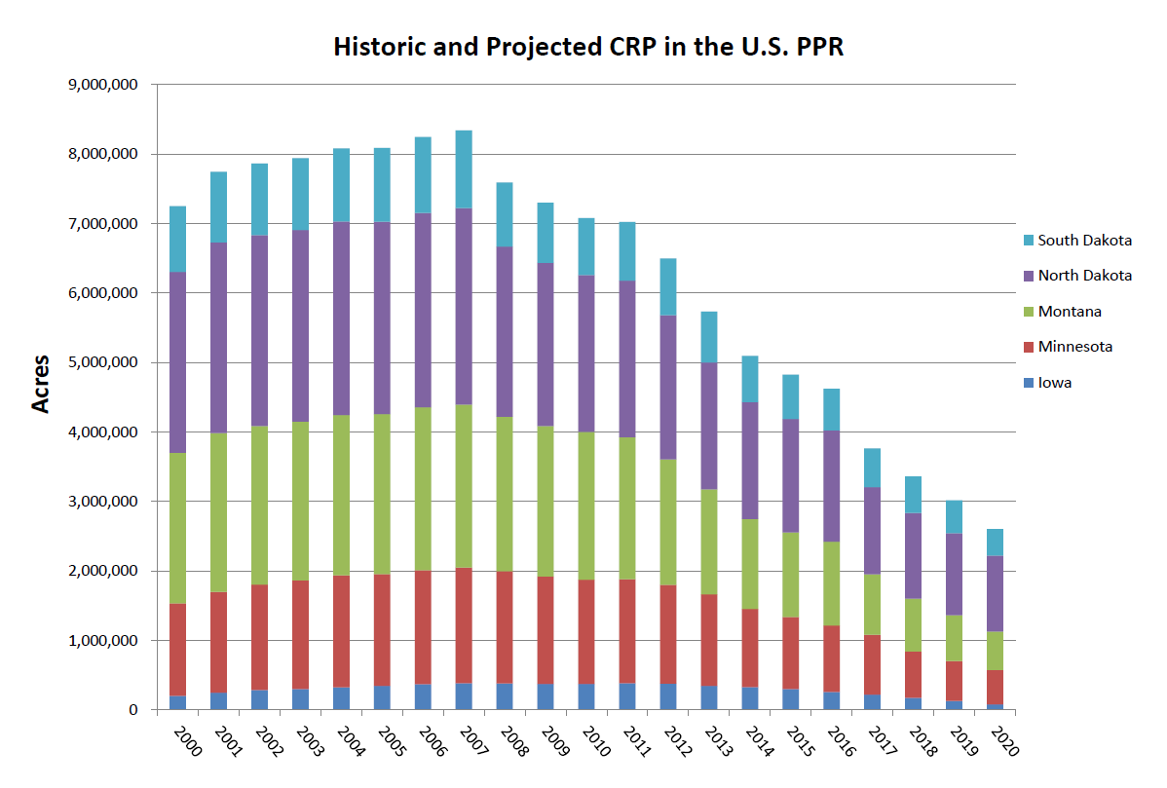
REVERSION OF CRP LANDS

Slide 44
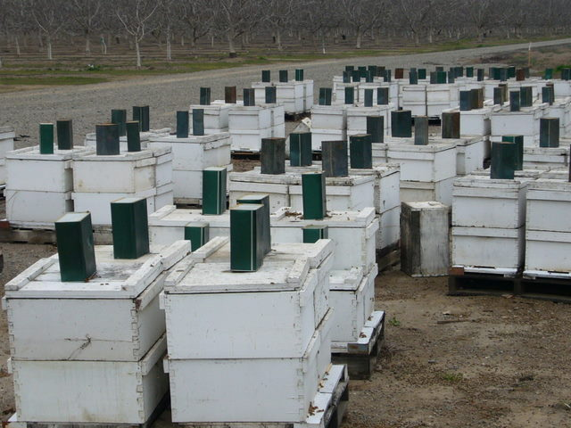
In many areas bees require supplemental feeding to survive.

Slide 45
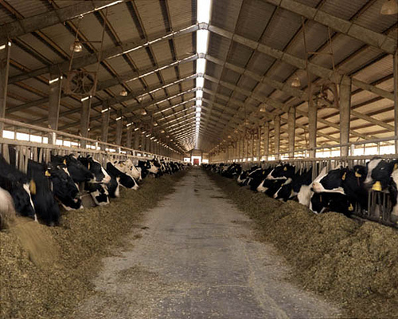
WE ARE BEING FORCED TO ADOPT THE
CONCENTRATED ANIMAL
FEEDING OPERATION
MODEL

Slide 46
Signs of improvement

Slide 47
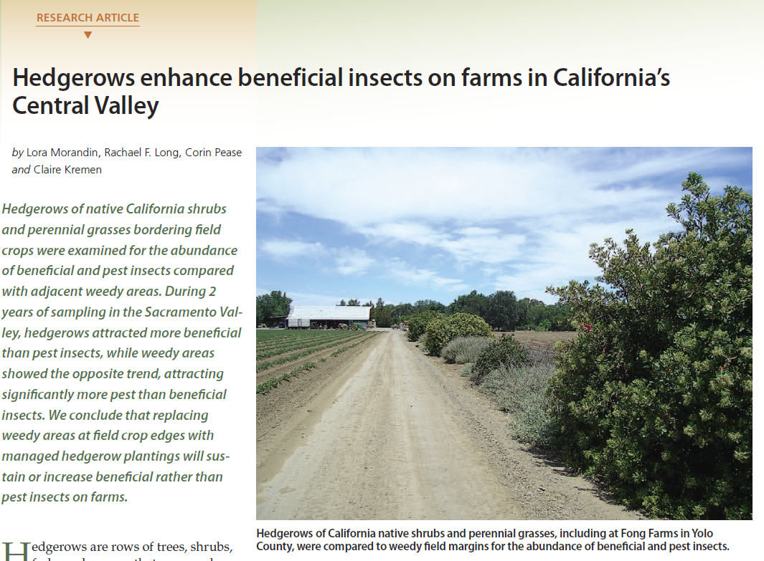

Slide 48
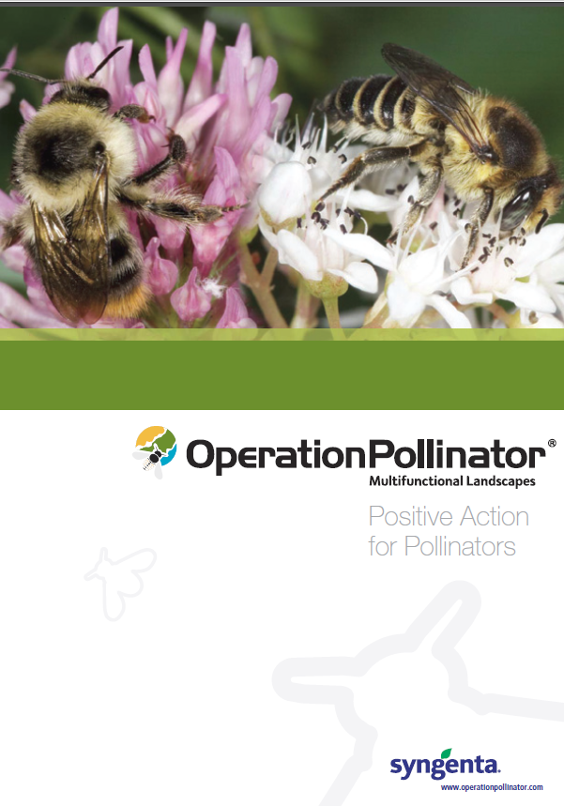

Slide 49
PESTICIDES

Slide 50
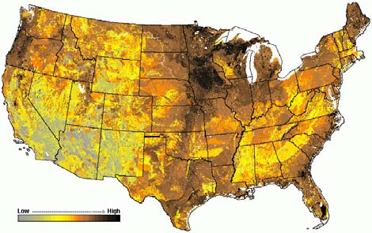
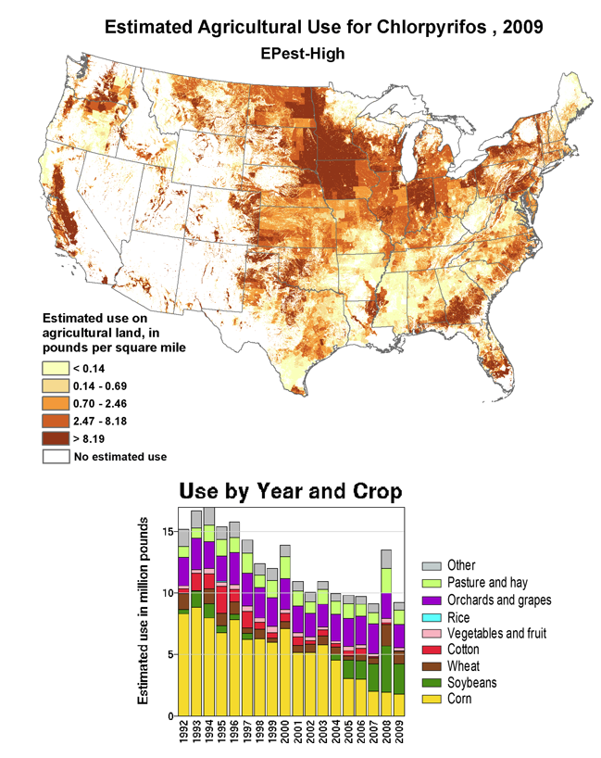
Biologically productive lands
INSECTICIDE EXPOSURE
Applications of the most common insecticide found in bee-collected pollen

Slide 51
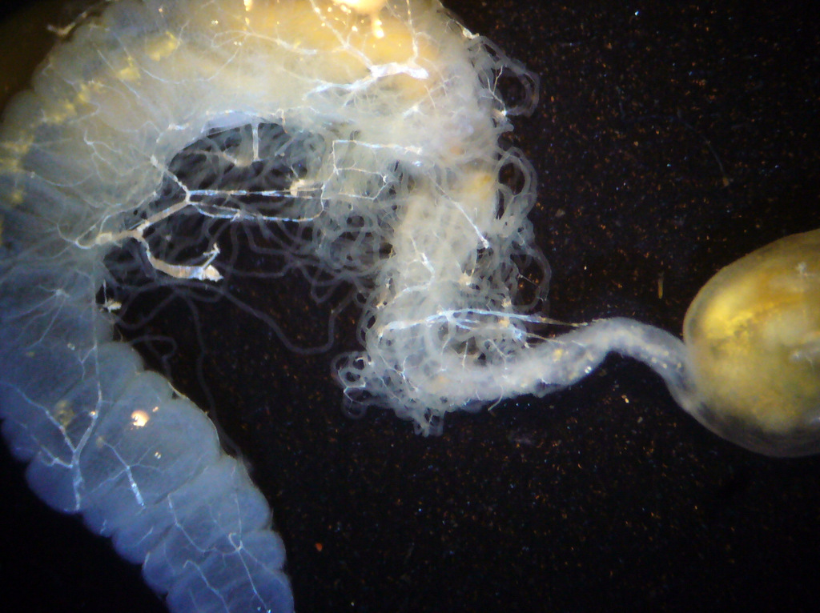
The Malpighian tubules and ileum perform detoxification, immune, and excretory functions analogous to the human liver and kidney.

Slide 52
Collateral damage from mite treatments
2012 USDA survey of 99 beebread samples from Alabama, California, Colorado, Florida, Idaho, Indiana, New York, South Dakota, Tennessee, Texas, and Wisconsin.

Slide 53
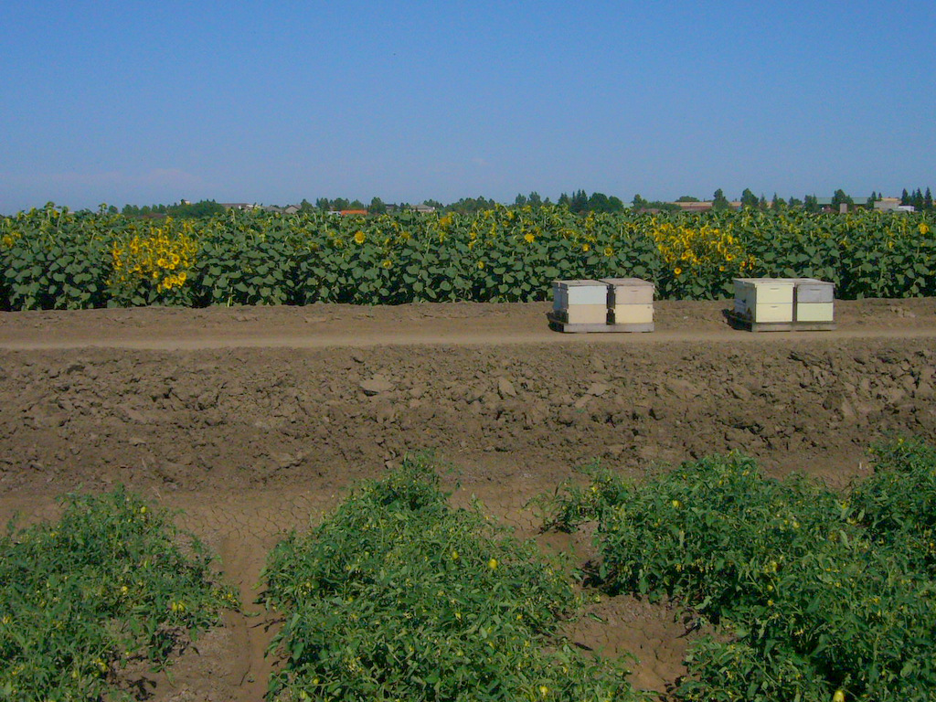
Agricultural pesticides

Slide 54
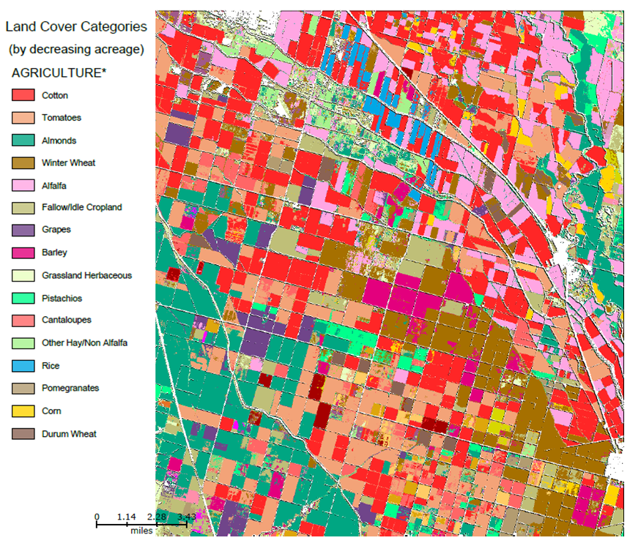

Slide 55
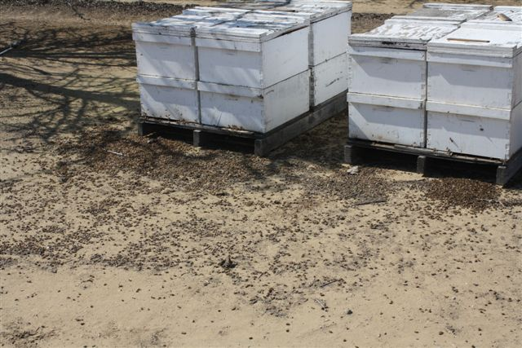

Slide 56

Pesticide roulette
Fungicides, surfactants, neonics, synergies

Slide 58
A warmer climate means more pesticide use!

Slide 59
misdirected activism?

Slide 60
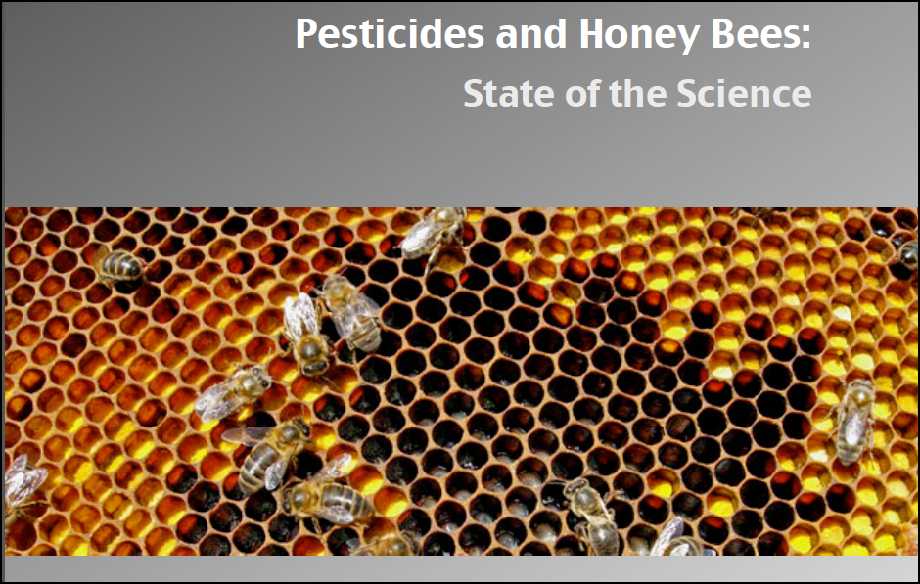


Slide 61
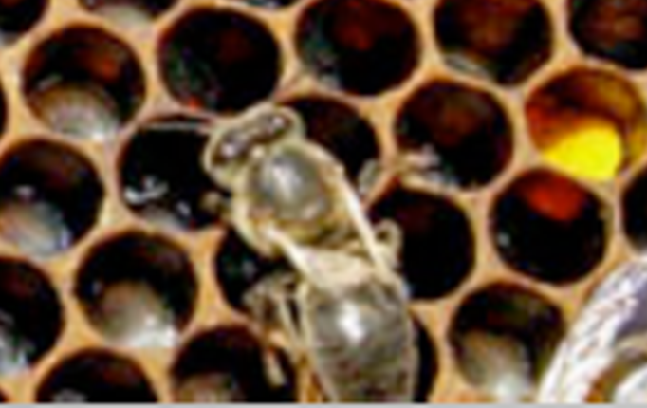

Slide 62
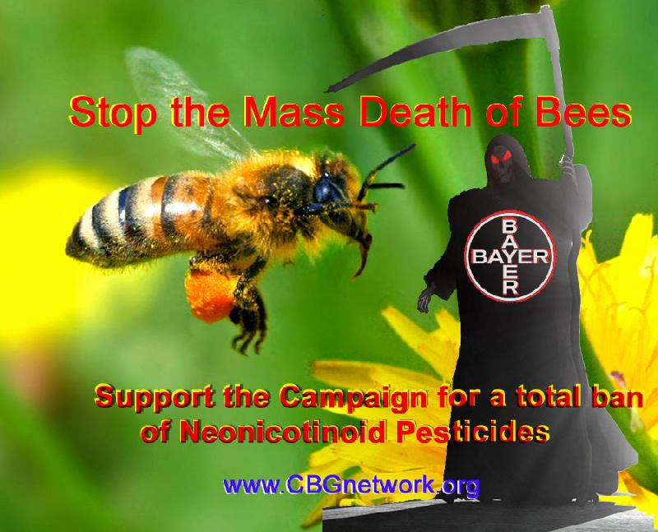

Slide 63
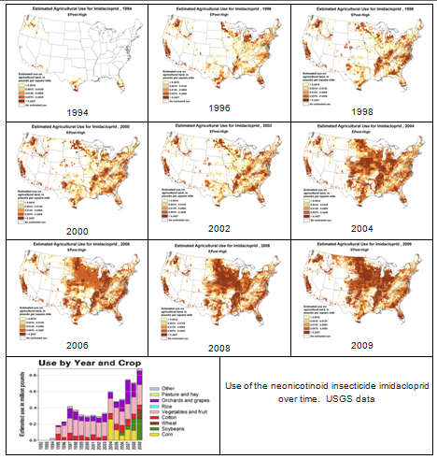

Slide 64
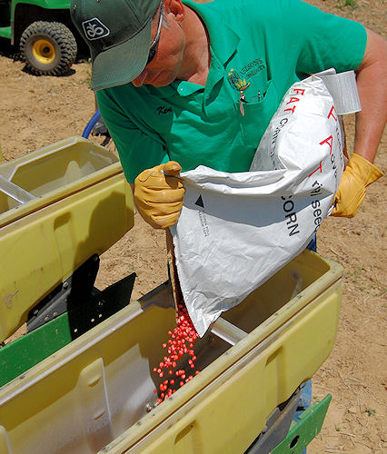
Treated seed ideally minimizes environmental exposure

Slide 65
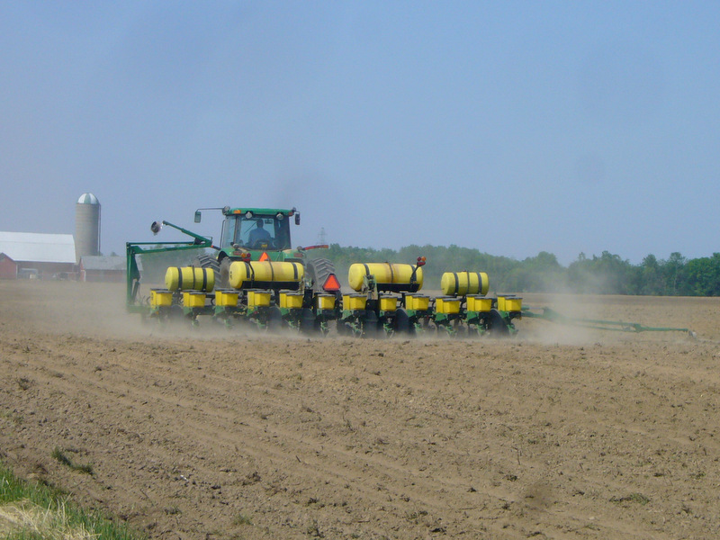

Slide 66
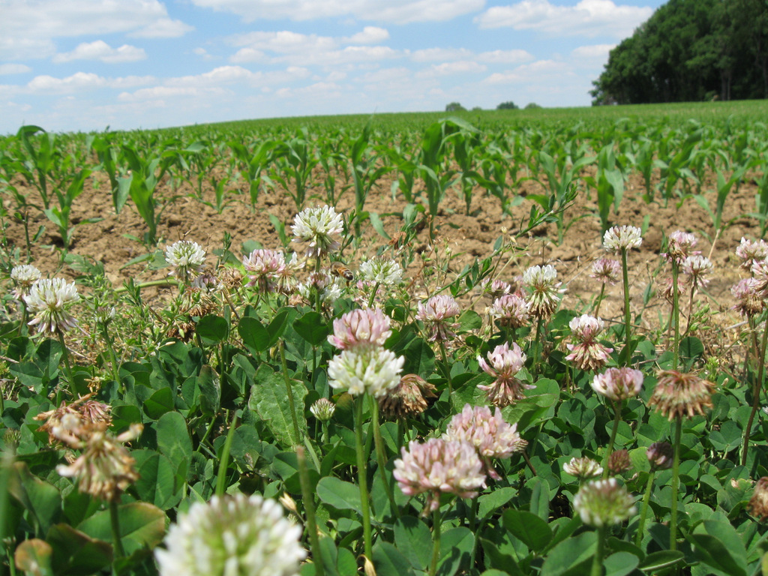

Slide 67

PESTICIDE APPLICATION
IN HIVE PATHWAYS AND CHECKPOINTS
© Randy Oliver 2014
Direct contact
Direct contact
“FIELD FORCE”

VAPOR
Direct contact
QUEEN
Direct contact
HIVE BEES
DIRECT CONTACT
Direct contact
RETURNINGFORAGERS
IN NECTAR, WATER, GUTTATION FLUID
MID-AGE BEES
RESIDUES IN NECTAR/HONEY
LARVAE
NECTAR/WATER FORAGERS
JELLY
Direct contact
NURSES
DUST/DUSTY RESIDUES
PUPAE
RESIDUES IN WAX
POLLEN FORAGERS
BEEBREAD
IN/ON POLLEN
NEWLY-EMERGED BEES (“POLLEN HOGS”)
POLLEN FORAGERS

Slide 68

Jim Doan

Slide 69


Slide 70

"All things are poison, and nothing is without poison; only the dose permits something not to be poisonous.“--Paracelsus

Slide 71

Larry Garrett

Slide 72


Slide 73


Slide 74

Todd Yakismishen

Slide 75
Reality check:
no detects of clothianidin
2012 USDA survey of 99 beebread samples from Alabama, California, Colorado, Florida, Idaho, Indiana, New York, South Dakota, Tennessee, Texas, and Wisconsin.

Slide 76

NEONICOTINOIDS:
Not enough compelling evidence to convict.
But not innocent either.

Slide 77
Signs of improvement

Slide 78

historical reality check of wax contamination

Slide 79
Pesticides in an old piece of beeswax foundation.
Positive residue detect | ppb
Pendimethalin | 13.1
Endrin | 156
Dieldrin | 160
Trifluralin | 3.6
DDT p,p' | 32.7
Heptachlor | 35.1
Malathion | 4.3
Chlorpyrifos | 4.6
Dicofol | 6.8
PCB's | 8190
Chlorothalonil | 84.6

Slide 80


Slide 81





Slide 82

Could it be GMO’s?

Slide 83

Unwarranted demonization

Slide 84


Slide 85


Bt corn pollen
Conventional corn pollen
Natural toxic pollen

Slide 86

Indirect effect: RR crops allow reduced tillage planting with heavy herbicide use.

Slide 87

State of Iowa

Slide 88
DO THE MATH:
200,000 more humans every day
~2 Acres to feed/fiber each human =
400,000 acres of virgin wildlife habitat converted to farmland every single day.
Our Choices:
Decrease the human population, destroy more wildlife habitat, or increase production on existing farm acreage.

Slide 89

Reality check:
GMO fear mongering is unwarranted.
GE crops are the most thoroughly tested foods in the market.
GE crops can reduce insecticide use, and hold
great promise for eco-friendly agriculture.
Melody Seppi

Slide 90
The solutions

Slide 91
Beekeeping practices must adapt and evolve

Slide 92

Beekeeping is no longer as it used to be.

Slide 93

Progressive beekeepers are learning successful management practices.

Slide 94
Bees must evolve to adapt to the changes

Slide 95


Domestic livestock are bred for productivity…
under conditions of intensive husbandry.

Slide 96

Selective
breeding
creates
genetic
bottlenecks

Slide 97


Slide 98

Our current breeds of bees
require a lot of help.

Slide 99

Domesticated bees require husbandry and regular treatment to survive.

Slide 100

We need to get serious about propagating varroa and virus resistant stocks!

Slide 101


Managed hives act as pathogen host reservoirs—
“Pathogen pollution”
Parasites and pathogens

Slide 102

Locally-
adapted
feral
survivor
stocks

Slide 103

Domesticated bees are bred for traits other than survivorship.

Slide 104
WHAT YOU CAN DO

Slide 105
INFLUENCE YOUR REPRESENTATIVES

Slide 106

Write your congresspersons to:
Firmly support the EPA—they face a hostile Congress.
Allocate more money towards the Conservation Reserve Program.
Make crop insurance payments conditional upon conservation practices.
Preserve and promote wildlife habitat in agricultural lands.
End the corn ethanol mandate.
Don’t waste your time with internet form letters.

Slide 107
VOTE WITH YOUR DOLLARS

Slide 108

Consumer demand drives agricultural practices
Notes:
What can the beekeeper due to help his bees?

Slide 109

VOTE EACH TIME YOU SPEND YOUR DOLLARS!
Support non-corporate agriculture.
Buy locally-produced fruits, nuts, and vegetables.
Patronize small farms and ranches.
Support eco-friendly farming and ranching.
Demand grass-fed beef and dairy.
Be active in conserving wildlife habitat on public lands.

Slide 110

Suggested reading:
The Extinction of the Honey Bee
What Happened to the Bees This Spring?

